Slide 1

Automated Rubber Solution Mixer
IN 1900 ICT PROJECT
Group No : 30

Slide 2

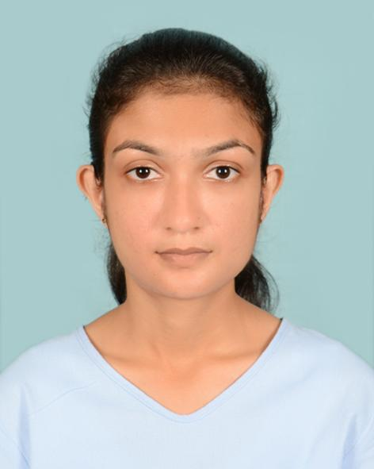



Group Members
 | Name | Reg No | Photo
Group leader | GITHMI P H | 204061V
Participant 1 | PERERA W C P I | 204157V
Participant 2 | SUDUSINGHE N E | 204208F
Participant 3 | NISHSHANKA W L A | 204142V
Participant 4 | SWANTHRA W K M | 204210E

Slide 3

Problem in brief
After the latex is collected from a rubber tree through the process of rubber tapping, the makers have to make rubber sheet. Here, the accuracy and quality of the rubber mixture are low as the ingredients are measured by the people. And also, the labor cost is high and the amount of output is low in manual processing.

Slide 4
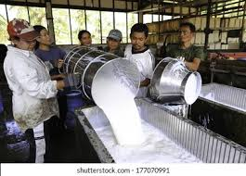
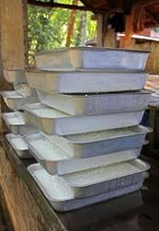
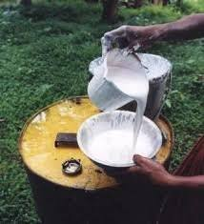
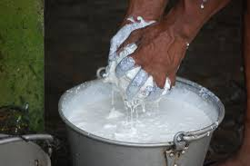
Manual Processing

Slide 5

Project Aim & Objectives
Aim
Design and develop an automated rubber solution mixer for small-scale rubber manufacturers.

Slide 6
Objectives
To increase the accuracy and quality of rubber sheets by automating the process.
To increase the efficiency of the machine by saving time spent on making rubber sheets.

Slide 7
Objectives(Cont.)
To reduce the processing time of a rubber sheet by automating the manual process.
To motivate the youth for small-scale rubber sheet making because of the easiness of handling this machine.

Slide 8

Proposed Solution
Display No of Trays / Volumes of Liquids
No of trays/Volume of Liquids
Key Pad
Microcontroller
Process 1
LCD
Distance to the Level of the Liquid
Display Tank Liquid Status
Ultrasonic Sensors
Process 2
Stepper Motor
Pushes a tray onto the conveyor belt
Rotate Motor
Process 3
Availability of the Tray
Stepper Motor
Controlling DC motor’s up and down movements
Rotate Motor
IR Sensor
Process 4

Slide 9
Proposed Solution (Cont.)
Ph Level of Latex
Microcontroller
Ph Sensor
Process 5
Rotate Motor
DC Motor
Controlling the mixing tool
Process 6
The Volume of Liquid
Turn on the Pump
Water Pump
Pumping liquid into the tray
Flow Sensor
Process 7
AC Motor
Controlling the conveyor belt
Rotate Motor
Process 8

Slide 10
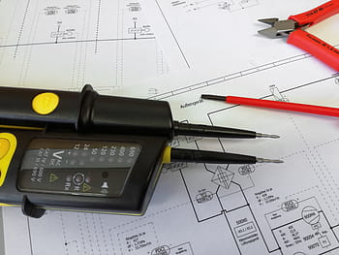
Circuit Diagram

Slide 11
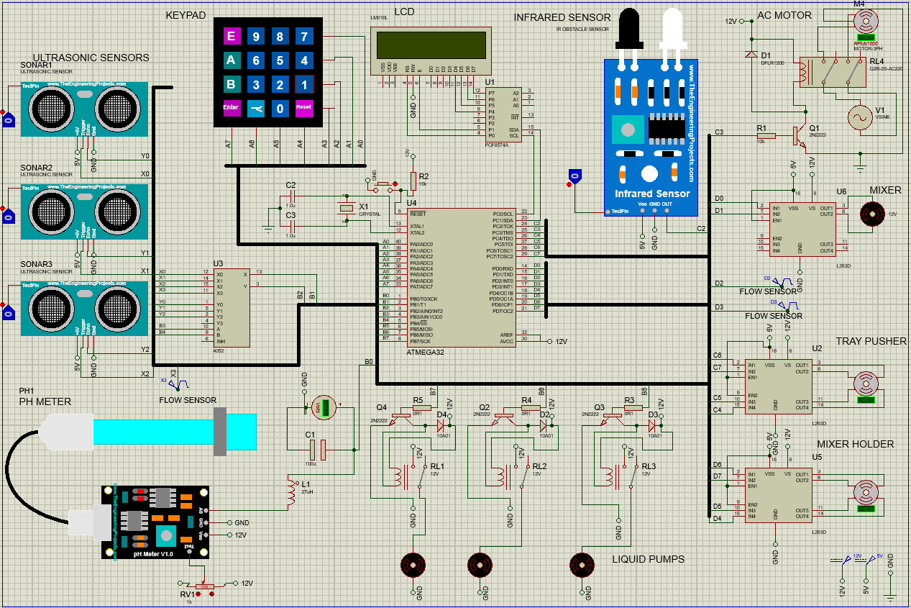

Slide 12
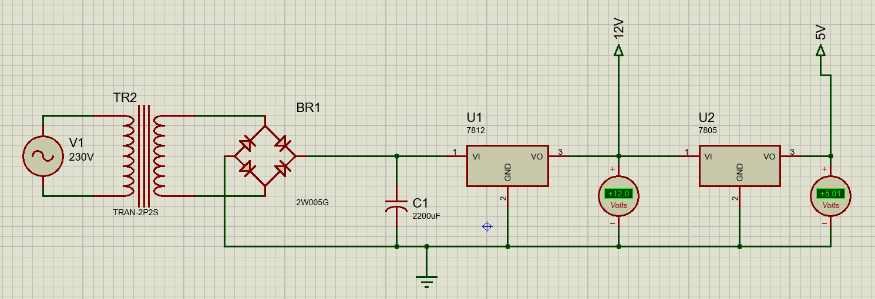
Power Supply

Slide 13
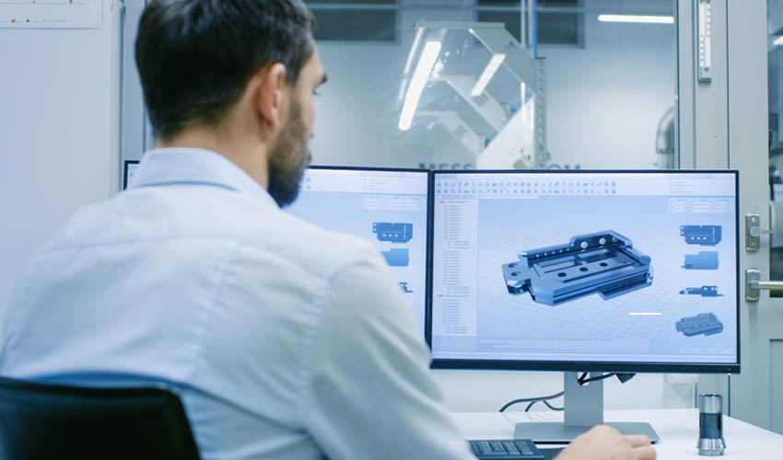
3D Model of
Automated Rubber Solution Mixer

Slide 14
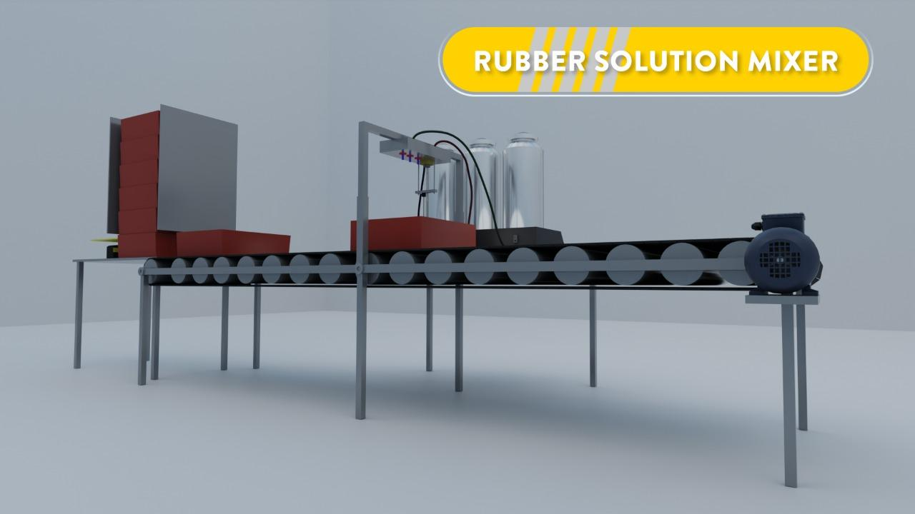

Slide 15
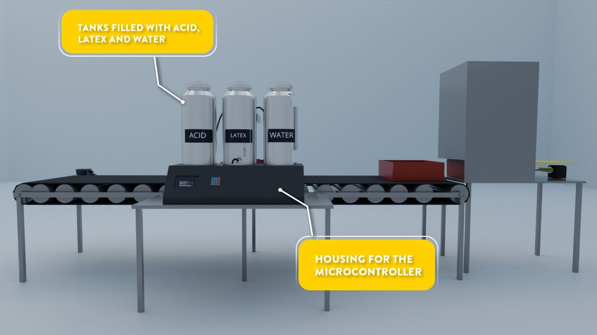
Tray
Tray

Slide 16
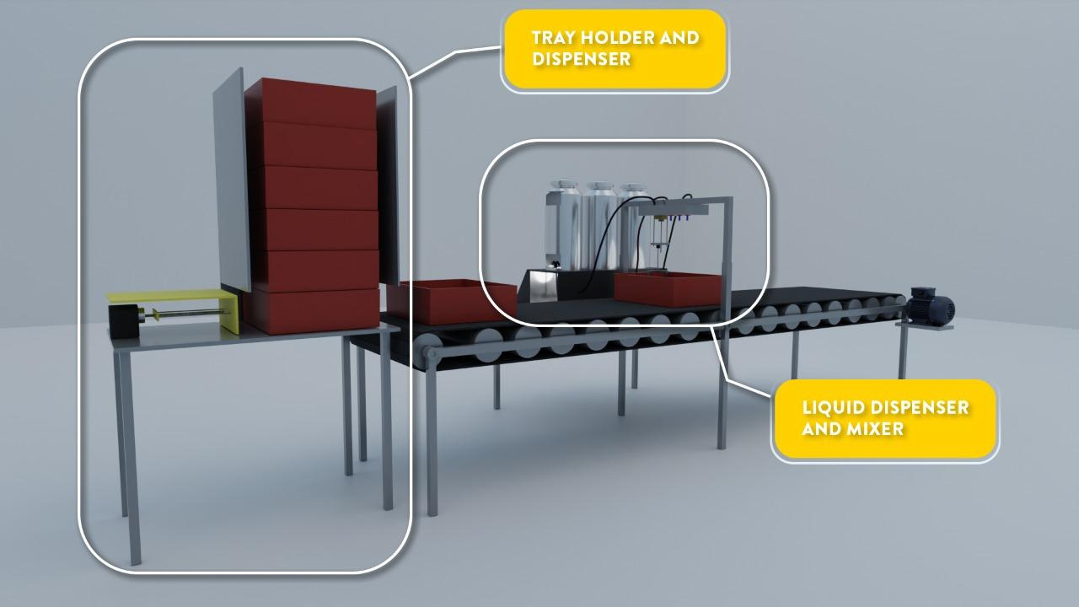

Slide 17
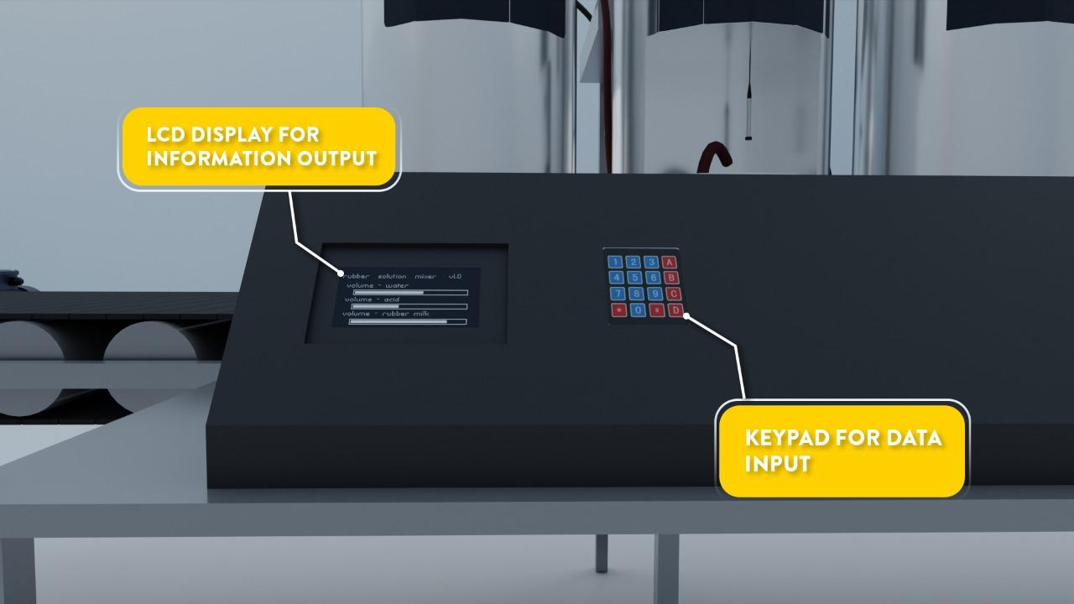
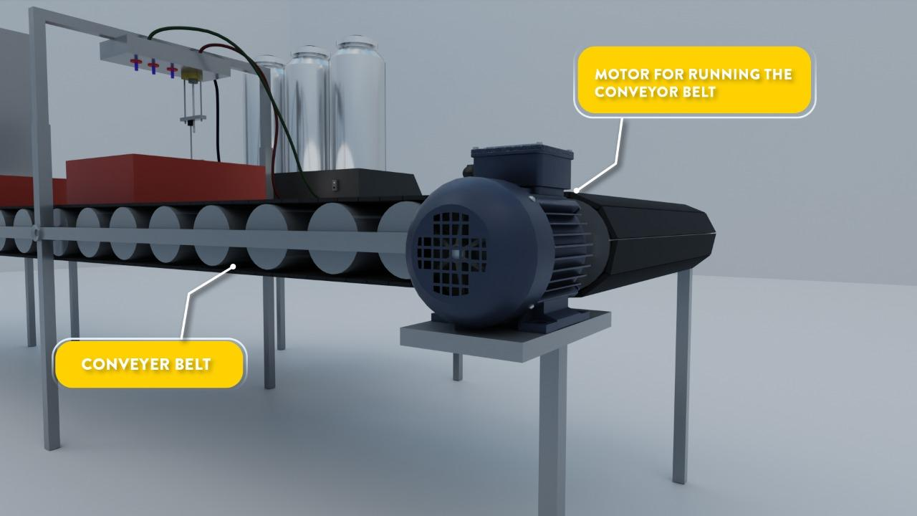
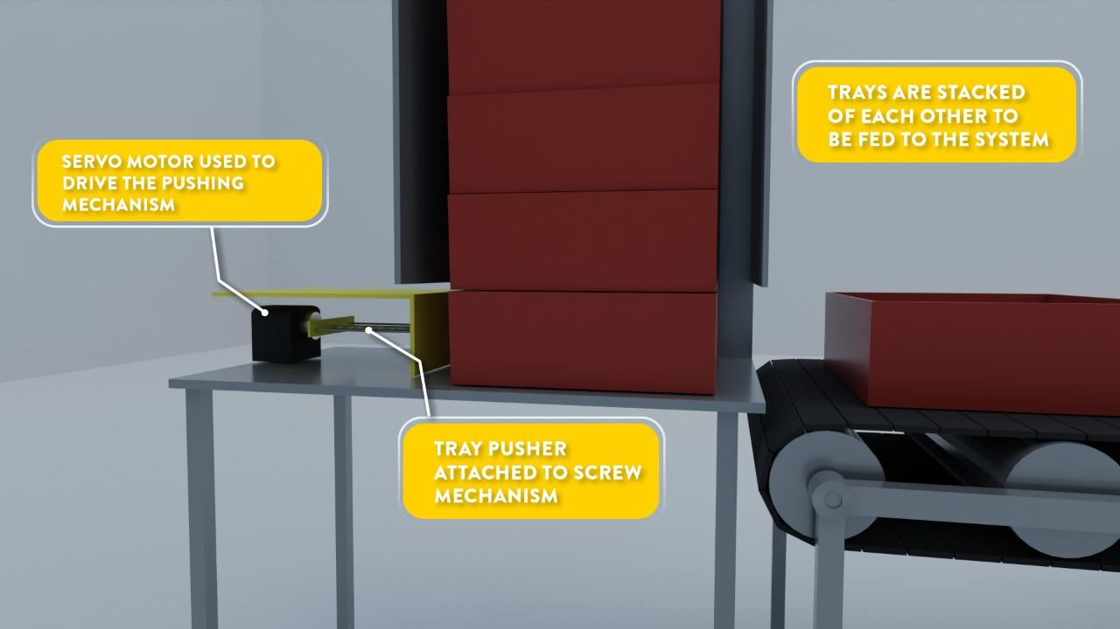
Tray

Slide 18
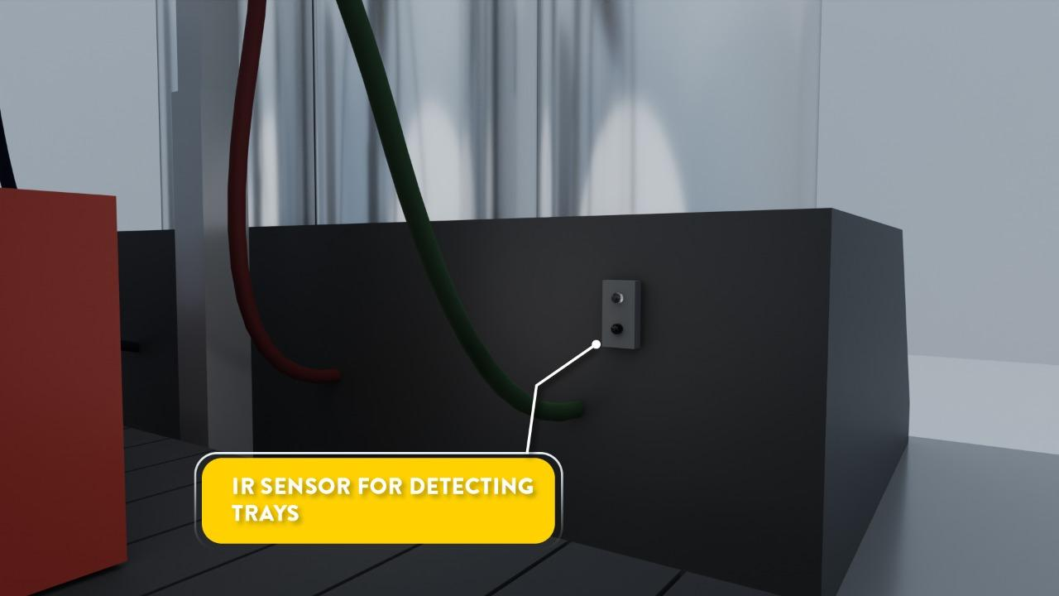
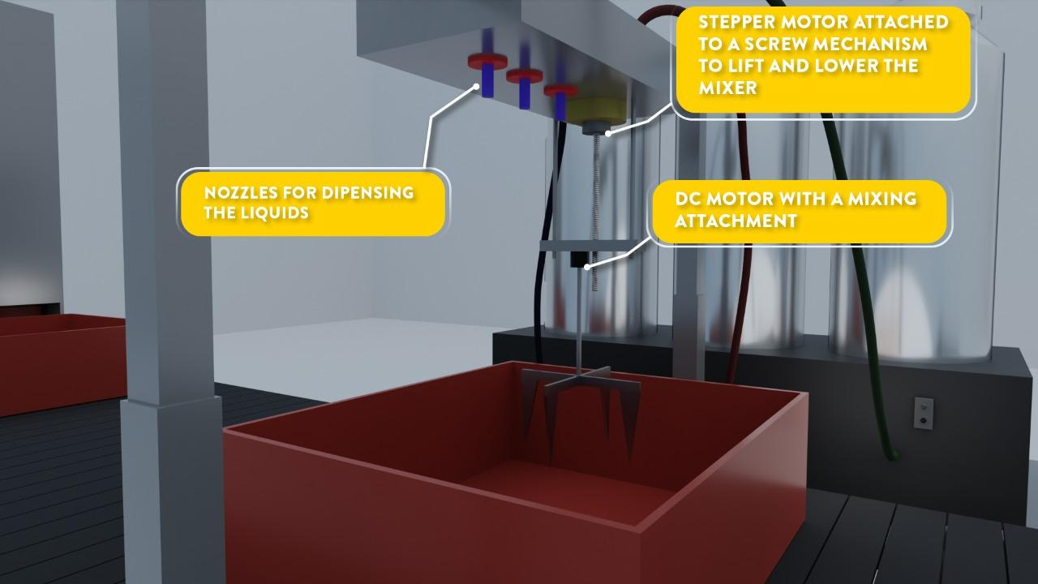
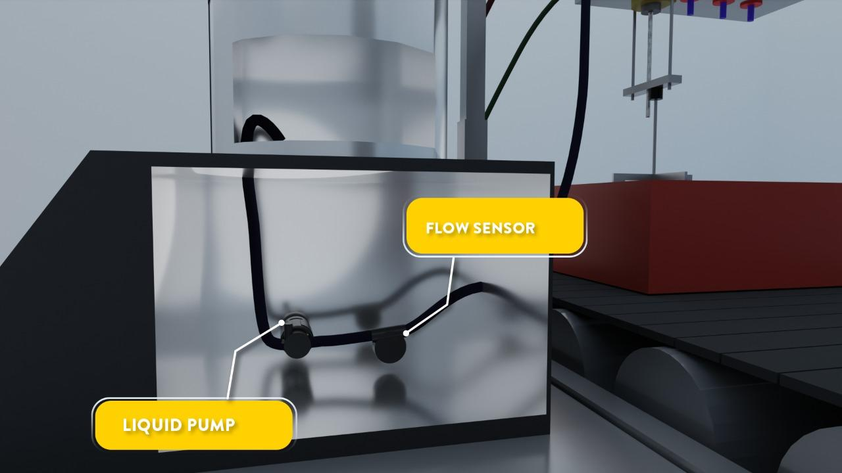
Tray

Slide 19
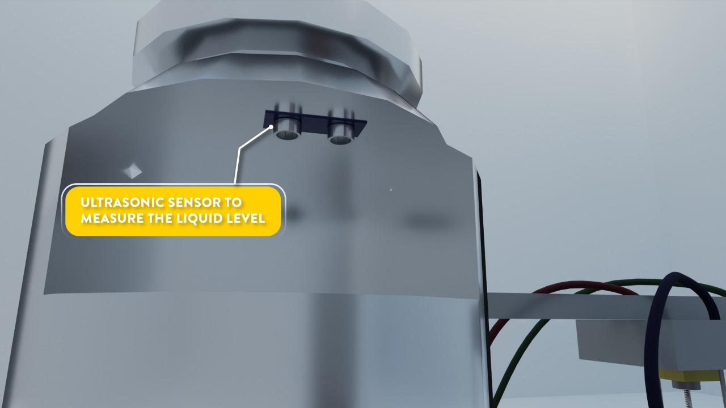
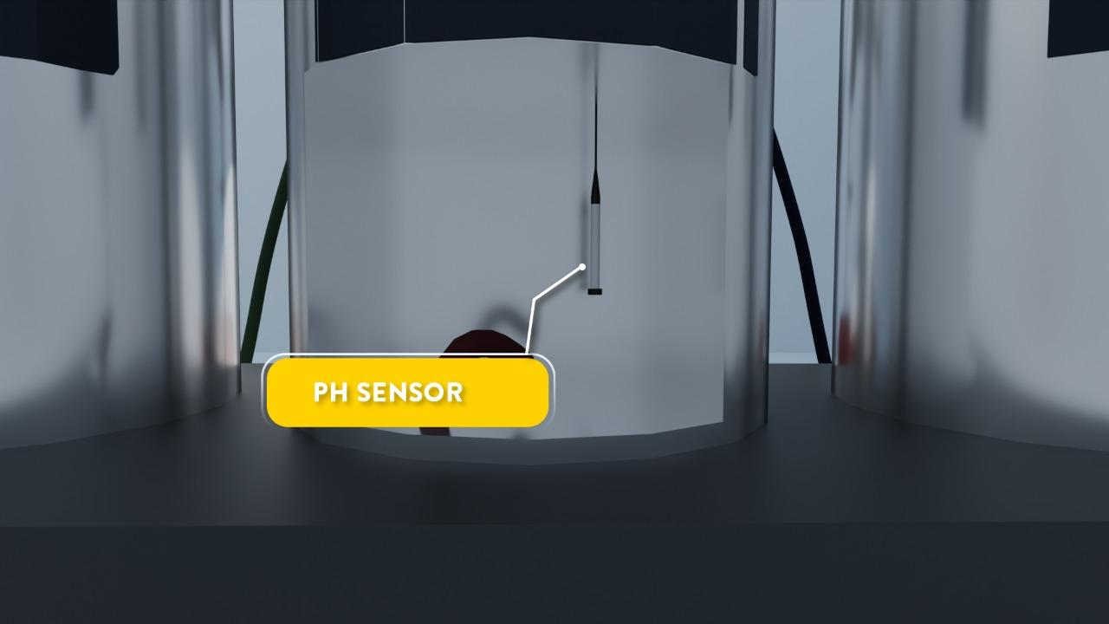
Tray Holder
Tray
Tray Collector

Slide 20


3D Animation
Link:https://drive.google.com/file/d/18WTmmTPVIKMQWcARAg5cu7Rj5KytGqKz/view?usp=sharing

Slide 21
Insert Video

Slide 22

Resource Required
Hardware :
Ph Sensor
Flow Sensor
IR Sensor
LCD
Keypad
DC Motor
AC Motor
Ultrasonic Sensors
Tanks
Water Pumps
Convey Belt
Mixture Tool
Stepper Motors
pipes(1m)
Motor drivers

Slide 23




Software :
Microchip Studio
Proteus
GitHub
Blender

Slide 24

Cost Estimation
Components | Quantity | Price (Rs)
Ph Sensor | 1 | 3800.00
Flow Sensor | 3 | 1950.00
Water Pump | 3 | 885.00
LCD | 1 | 330.00
AC Motor | 1 | 1000.00
IR Sensor | 1 | 175.00
Keypad | 1 | 160.00
Ultrasonic Sensor | 3 | 675.00
Motor for Conveyor Belt | 1 | 2800.00
Atmega32 Microcontroller | 1 | 600.00

Slide 25

Cost Estimation (Cont.)
Components | Quantity | Price (Rs)
Conveyor Belt | 1 | 3000.00
Tank(10l) | 3 | 1500.00
Mixing Component | 1 | 100.00
NEMA 17 Stepper Motor | 2 | 3600.00
L293D Motor Driver | 3 | 1470.00
Pipes(1m) | 5 | 550.00
DC Motor for Mixer | 1 | 500.00
Other Components |  | 1000.00
 | TOTAL | 24095.00

Slide 26

Individual
Contribution

Slide 27
Member 1: Githmi P H (204061V)
Responsibilities:
Developing C code for the IR Sensor and Stepper Motors
Connecting the IR sensor and stepper motors to the Atmega32 microcontroller.

Slide 28
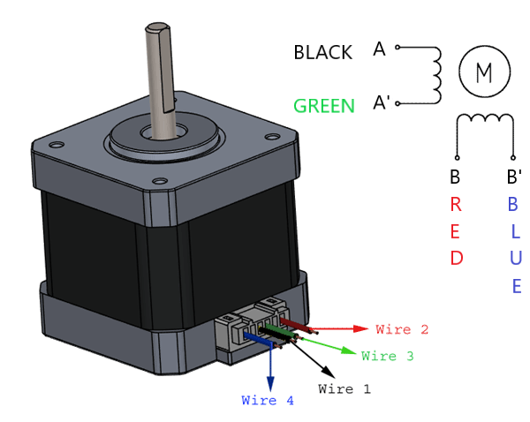
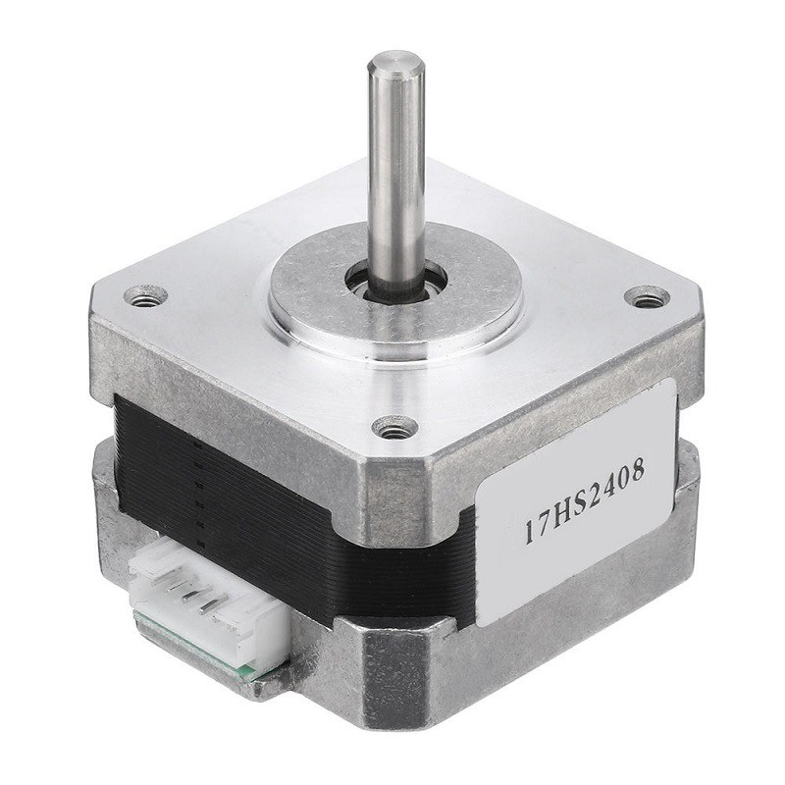
Stepper Motor
Step Angle: 1.8°
Driving Voltage(Max): 24 V
Rated Current(Max): 0.6A
Holding Torque: 12Ncm

Slide 29
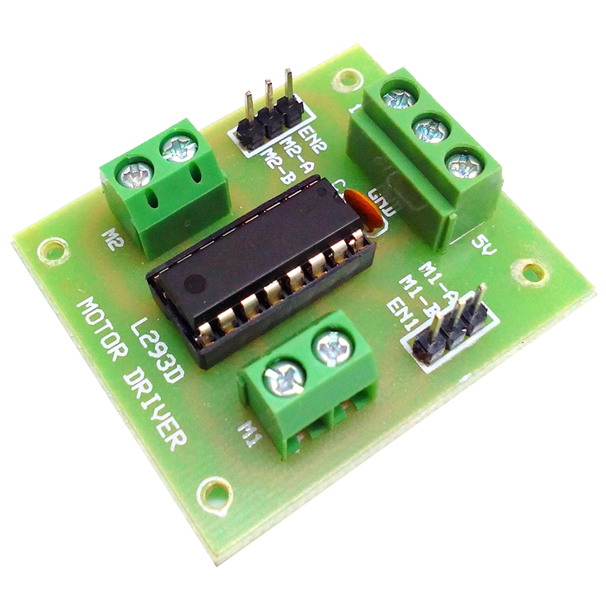
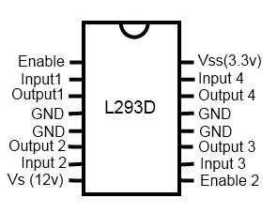
L293D Motor Driver
Supply Voltage(Max) : 36V
Input Voltage(Max) : 7V
Output Current(Max) : 1.2A

Slide 30
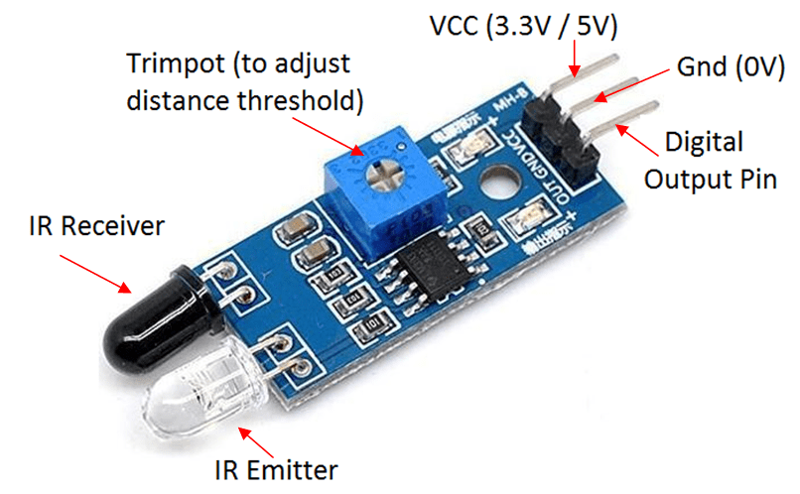
IR Sensor
Max Current: 20mA
Max Voltage: 5V
Detect Distance Range: 0cm -20cm

Slide 31
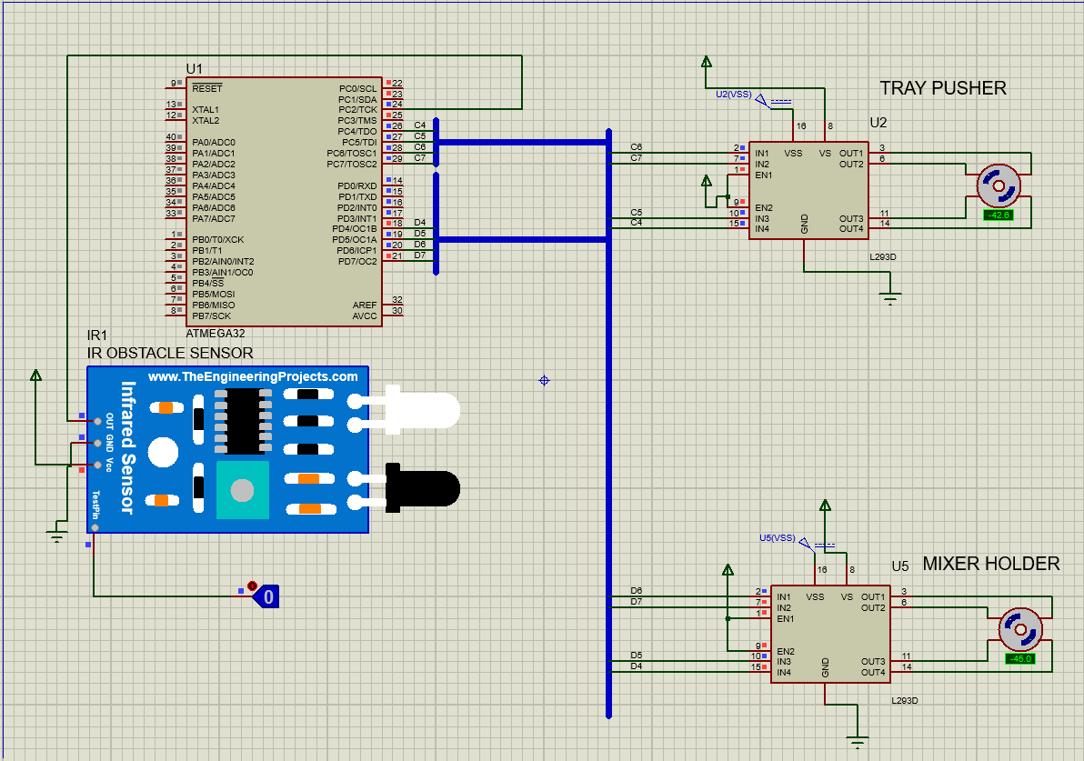
Circuit Diagram

Slide 32
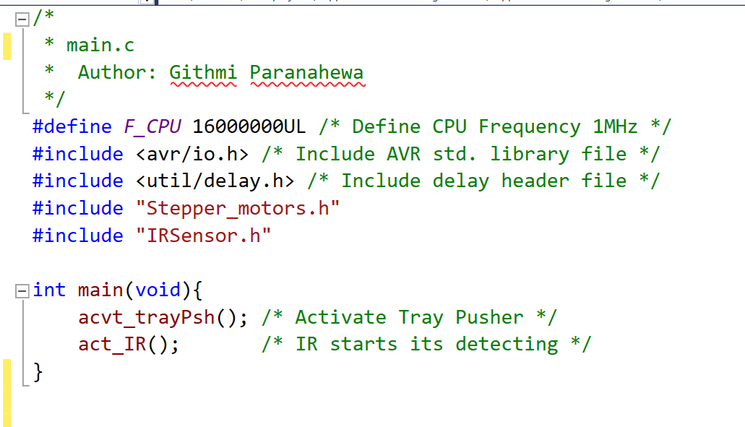
Code

Slide 33
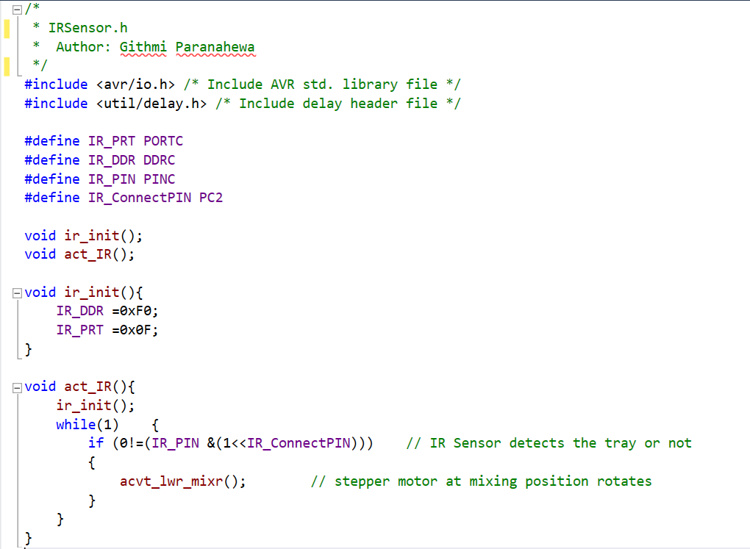

Slide 34
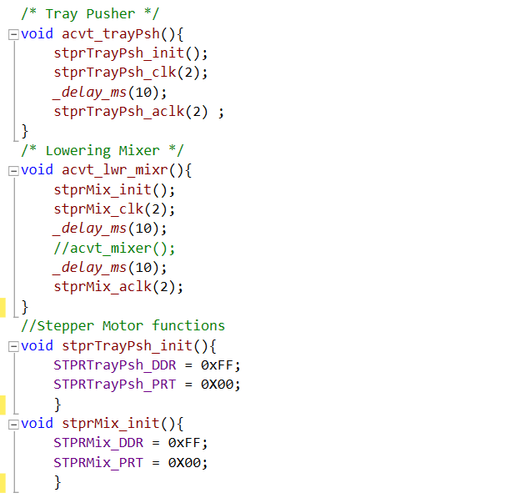
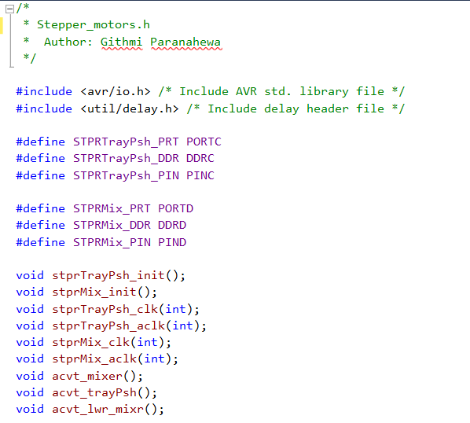

Slide 35
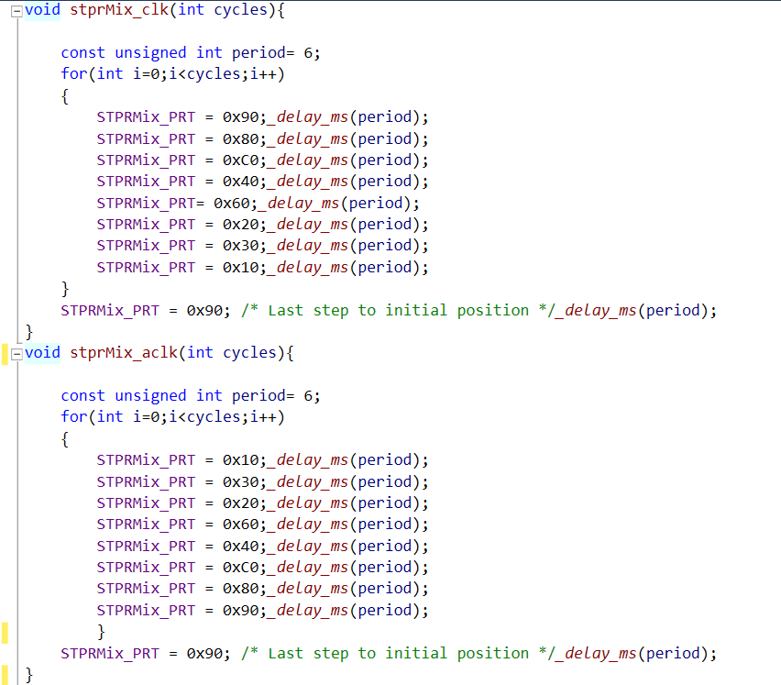
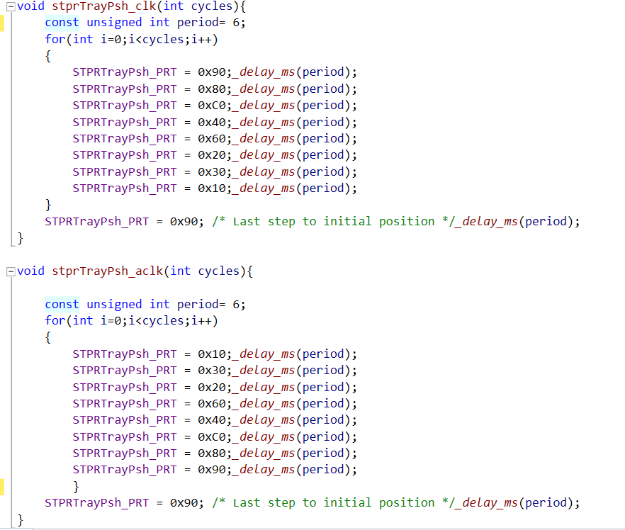

Slide 36
Data Sheet Links
NEMA 17 17HS2408:
https://pdf1.alldatasheet.com/datasheet-pdf/view/1137267/MOTIONKING/17HS2408.html
L293D Motor Driver:
https://pdf1.alldatasheet.com/datasheet-pdf/view/22432/STMICROELECTRONICS/L293D.html
IR Sensor:
https://components101.com/sites/default/files/component_datasheet/Datasheet%20of%20IR%20%20Sensor.pdf

Slide 37
Member 2: Perera W.C.P.I (204157V)
Responsibilities:
Developing C code for the flow sensor and the water pump
Connecting flow sensors and the water pumps
to the Atmega32 microcontroller.

Slide 38
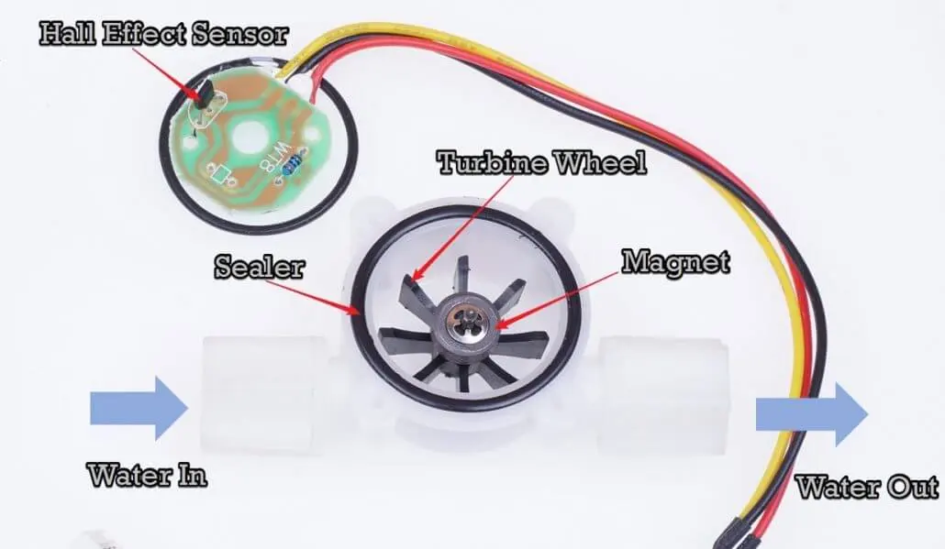
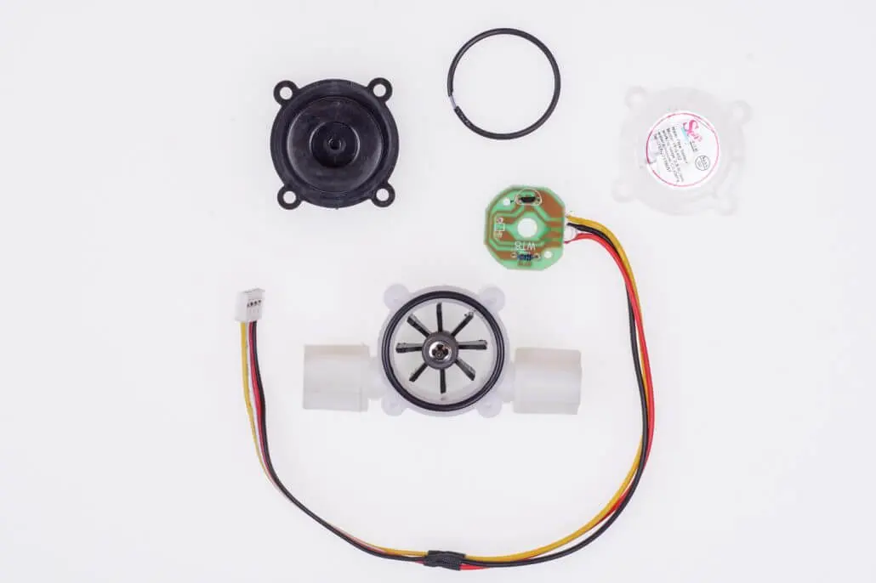
Flow Sensor
Min. Working Voltage: DC 4.5V
Max. Working Current: 15mA (DC 5V)
Working Voltage: DC 5V~24V
Water resistant 0.35MPa
Flow Rate Range: 1~ 5L/min

Slide 39
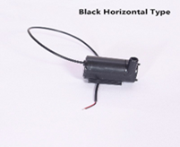
Water Pump
Input Voltage: 3.5-5V DC
Power: 1W
H.max.: 0.4-2.0M
Q.max.: 200L/H
Size: 38 * 34 * 27m

Slide 40
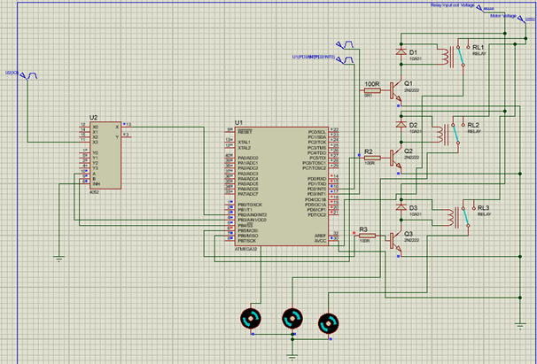
Circuit Diagram

Slide 41
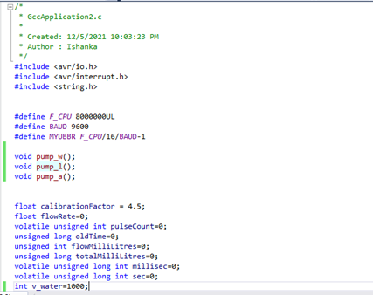
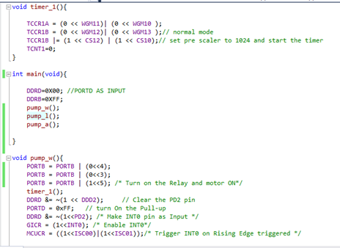
Code

Slide 42
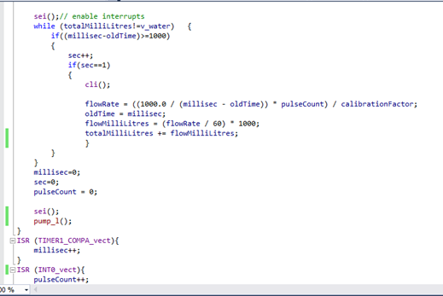
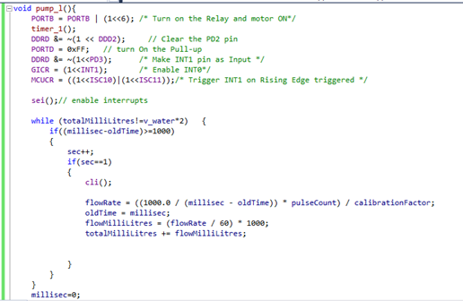

Slide 43
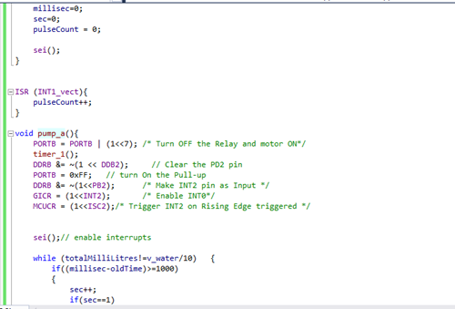
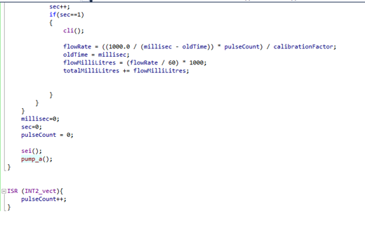

Slide 44
Data Sheet Links
Flow Sensor:
https://www.epitran.it/ebayDrive/datasheet/YF-S401.pdf
Water Pump:
http://www.brainzstore.com/admin/productimages/5V%20Mini%20Water%20Pump/water%20pump%20mini%205v.pdf
water pump mini 5v datasheet.pdf

Slide 45
Member 3: Sudusinghe N.E (204208F)
Responsibilities:
Developing C code for the Keypad and pH sensor
Connecting Keypad and pH sensor to the Atmega32 microcontroller.

Slide 46
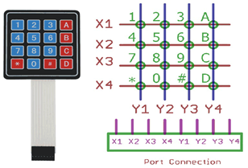
Keypad
Maximum Voltage across each segment or button: 24V
Maximum Current through each segment or button: 30mA
Maximum operating temperature: 0°C to + 50°C

Slide 47
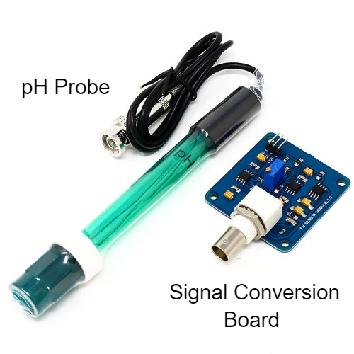
pH Sensor
pH Probe
Detection Range: 0~14
Temperature Range: 5~60°C
Zero Point: 7±0.5
Response Time: < 2min
Internal Resistance: < 250MΩ

Slide 48
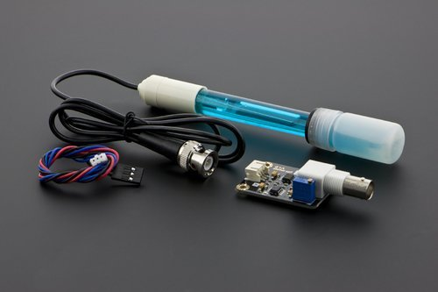
pH Sensor
Signal Conversion Board
Supply Voltage: 3.3~5.5V
Output Voltage: 0~3.0V
Measurement Accuracy: ±0.1@25℃
Signal Connector: PH2.0-3P

Slide 49
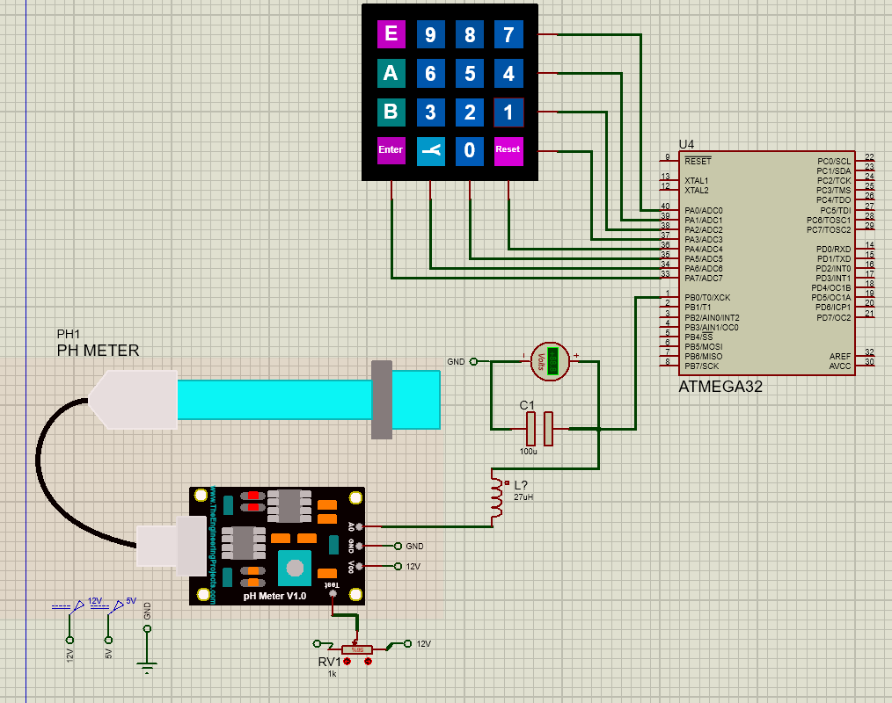
Circuit Diagram

Slide 50
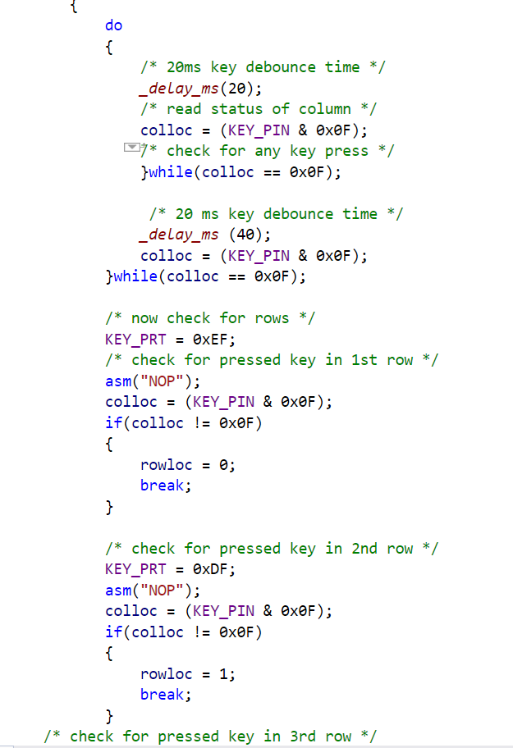
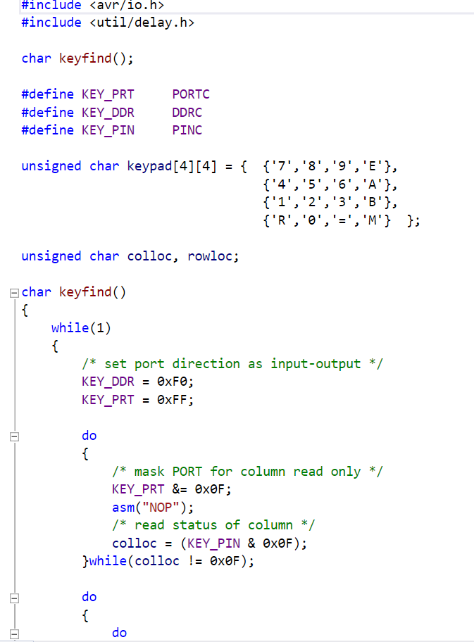
Code: Keypad

Slide 51
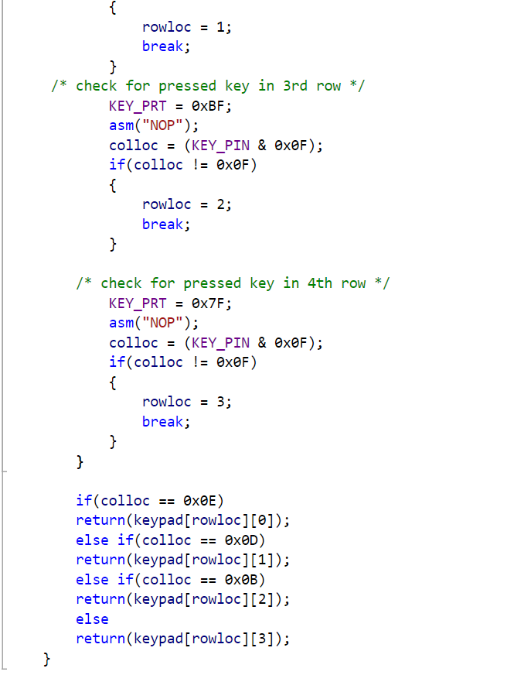

Slide 52
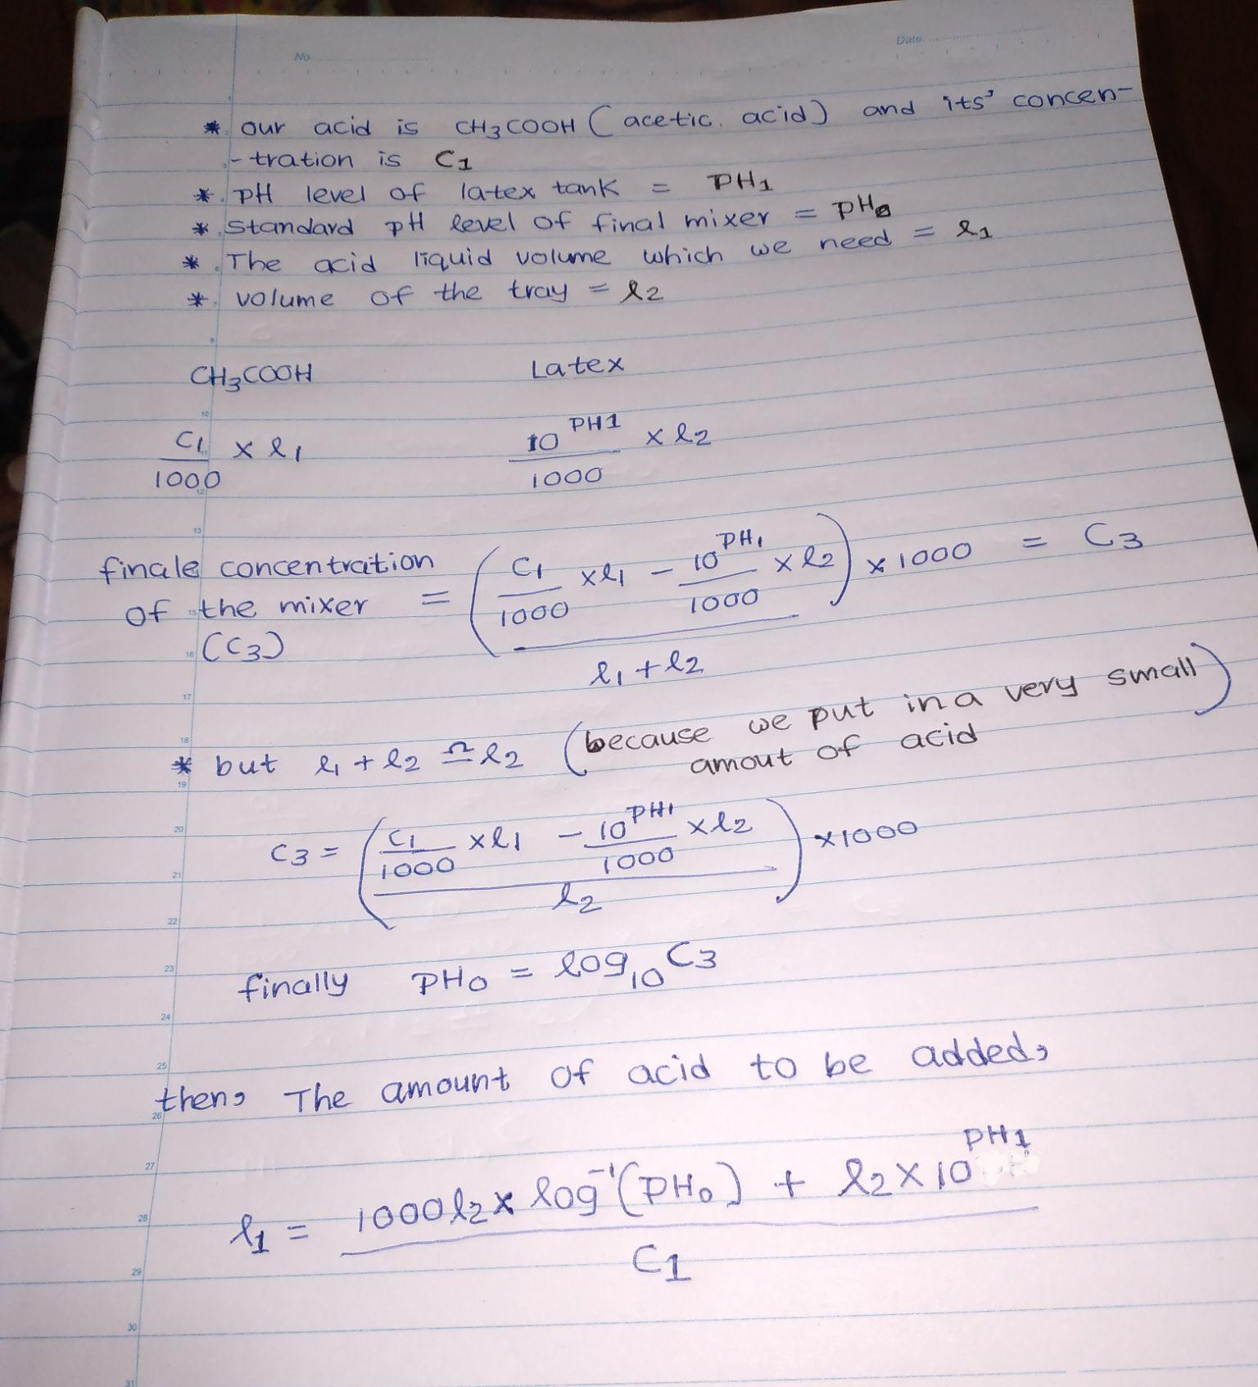
Calculation
pH Sensor

Slide 53
Data Sheet Links
pH Meter
https://www.application-datasheet.com/pdf/dfrobot/sen0161.pdf
Keypad 4x4
https://www.crameda.com/pdf_files/eng/keypads/Monobloc-3x4-4x4-DS-E.pdf

Slide 54
Member 4: Nishshanka W.L.A (204142V)
Responsibilities:
Developing C code for the AC motor and Ultrasonic Sensor
Connecting AC motor and ultrasonic sensor to the Atmega32 microcontroller.

Slide 55

Ultrasonic Sensor
Maximum Current: 15mA
Maximum Voltage : 5V
Detect Distance Range: 2cm -400cm
Measuring angle:15 degree
Dimension:45*20*15mm

Slide 56

4052 IC
4:1 Multiplexer IC
1:4 Demultiplexer IC
Supports both Analog and Digital Voltage
Maximum Operating Voltage: 20V
Propagation Delay: 400ns at 5V

Slide 57


AC Motor
Maximum Current: 0.9A
Maximum Voltage : 240V
Speed:6000 R/Min
Input power:120W

Slide 58

Circuit Diagram

Slide 59

Code:Control Ultrasonic Sensor

Slide 60



Slide 61


Slide 62

Code: Control Ac Motor Using Relay

Slide 63
Data Sheet Links
Ultrasonic Sensor
https://datasheetspdf.com/pdf-file/1380138/ETC1/HC-SR04/1
4052 IC
https://pdf1.alldatasheet.com/datasheet-pdf/view/50866/FAIRCHILD/CD4052.html

Slide 64
Data Sheet Links(Cont.)
Channel 1 Relay Module
https://components101.com/switches/5v-single-channel-relay-module-pinout-features-applications-working-datasheet
220V AC Motor
https://www.daraz.lk/products/sewing-machine-motor-120w-i104857125.html

Slide 65
Member 5: Swanthra W.K.M (204210E)
Responsibilities:
Developing C code for the LCD and DC Motor
Creating a 3D Model of the final Product and animation.

Slide 66


LCD and PCF8574A Module
Maximum Current: 2.5mA
Maximum Voltage : 6.5V
16 characters x 2 lines
Display area : 84mm x 44mm
Weight : 35g
Maximum Current: 100mA
Maximum Voltage : 7V

Slide 67

DC Motor
Operating Voltage(V): 12
Rated Speed (RPM): 200
Rated Torque(kg-cm): 1.5
Stall Torque(kg-cm): 5.4
Load Current (A): 0.3
No Load Current (A): 0.6

Slide 68
L293D Motor Driver
Supply Voltage(Max) : 36V
Input Voltage(Max) : 7V
Output Current(Max) : 1.2A

Slide 69

Circuit Diagram

Slide 70


Code : LCD

Slide 71




Slide 72

Code : DC Motor

Slide 73
Data Sheet Links
16x2 LCD Display:
https://www.sparkfun.com/datasheets/LCD/ADM1602K-NSW-FBS-3.3v.pdf
L293D Motor Driver:
https://pdf1.alldatasheet.com/datasheet-pdf/view/22432/STMICROELECTRONICS/L293D.html

Slide 74
Data Sheet Links(Cont.)
PCF8574A:
https://www.ti.com/lit/ds/symlink/pcf8574a.pdf?ts=1639539464373&ref_url=https%253A%252F%252Fwww.ti.com%252Fproduct%252FPCF8574A%253FHQS%253DTI-null-null-octopart-df-pf-null-wwe
DC Motor:
https://www.raveo.cz/sites/default/files/dkm/katalogy/motory/DC%20MOTOR%20(15W~120W).pdf

Slide 75

Thank you!
NiShshanka
Githmi
Ishanka
Milan
Eshan
Questions ?

